Slide 1
ICS 143 - Principles of Operating Systems
Lecture Set 4 - Process Synchronization
Prof. Nalini Venkatasubramanian
nalini@ics.uci.edu
Principles of Operating Systems - Process Synchronization
‹#›

Slide 2
Outline
The Critical Section Problem
Synchronization Hardware
Semaphores
Classical Problems of Synchronization
Critical Regions
Monitors
Principles of Operating Systems - Process Synchronization
‹#›

Slide 3
Producer-Consumer Problem
Paradigm for cooperating processes;
producer process produces information that is consumed by a consumer process.
We need buffer of items that can be filled by producer and emptied by consumer.
Unbounded-buffer places no practical limit on the size of the buffer. Consumer may wait, producer never waits.
Bounded-buffer assumes that there is a fixed buffer size. Consumer waits for new item, producer waits if buffer is full.
Producer and Consumer must synchronize.

Slide 4
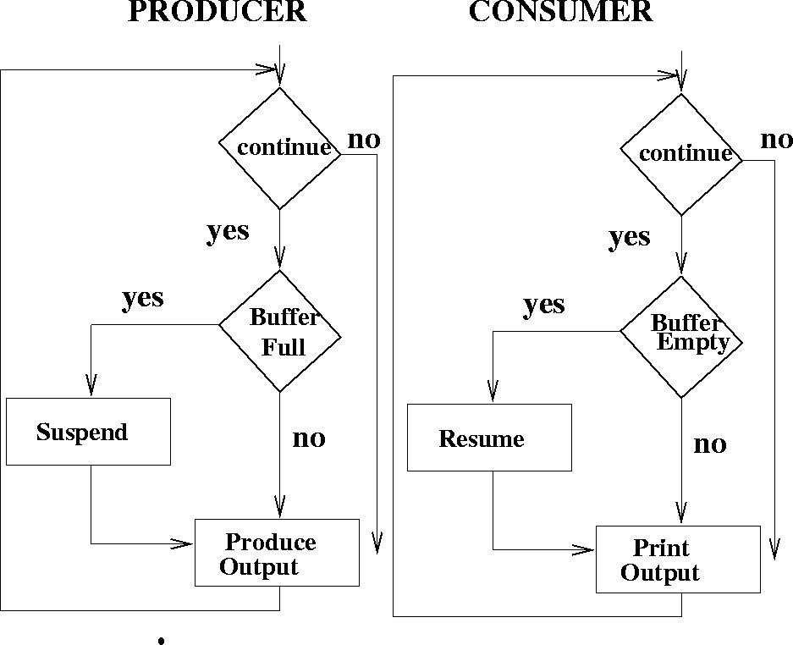
Producer-Consumer Problem

Slide 5
Bounded Buffer using IPC (messaging)
Producer
repeat
…
produce an item in nextp;
…
send(consumer, nextp);
until false;
Consumer
repeat
receive(producer, nextc);
…
consume item from nextc;
…
until false;

Slide 6
Bounded-buffer - Shared Memory Solution
Shared data
var n;
type item = ….;
var buffer: array[0..n-1] of item;
in, out: 0..n-1;
in :=0; out:= 0; /* shared buffer = circular array */
/* Buffer empty if in == out */
/* Buffer full if (in+1) mod n == out */
/* noop means ‘do nothing’ */

Slide 7
Bounded Buffer - Shared Memory Solution
Producer process - creates filled buffers
repeat
…
produce an item in nextp
…
while in+1 mod n = out do noop;
buffer[in] := nextp;
in := in+1 mod n;
until false;

Slide 8
Bounded Buffer - Shared Memory Solution
Consumer process - Empties filled buffers
repeat
while in = out do noop;
nextc := buffer[out] ;
out:= out+1 mod n;
…
consume the next item in nextc
…
until false

Slide 9
Shared data
Concurrent access to shared data may result in data inconsistency.
Maintaining data consistency requires mechanisms to ensure the orderly execution of cooperating processes.
Shared memory solution to the bounded-buffer problem allows at most (n-1) items in the buffer at the same time.
Principles of Operating Systems - Process Synchronization
‹#›

Slide 10
Bounded Buffer
A solution that uses all N buffers is not that simple.
Modify producer-consumer code by adding a variable counter, initialized to 0, incremented each time a new item is added to the buffer
Shared data
type item = ….;
var buffer: array[0..n-1] of item;
in, out: 0..n-1;
counter: 0..n;
in, out, counter := 0;
Principles of Operating Systems - Process Synchronization
‹#›

Slide 11
Bounded Buffer
Producer process - creates filled buffers
repeat
…
produce an item in nextp
…
while counter = n do noop;
buffer[in] := nextp;
in := in+1 mod n;
counter := counter+1;
until false;
Principles of Operating Systems - Process Synchronization
‹#›

Slide 12
Bounded Buffer
Consumer process - Empties filled buffers
repeat
while counter = 0 do noop;
nextc := buffer[out] ;
out:= out+1 mod n;
counter := counter - 1;
…
consume the next item in nextc
…
until false;
The statements
counter := counter + 1;
counter := counter - 1;
must be executed atomically.
Atomic Operations
An operation that runs to completion or not at all.
Principles of Operating Systems - Process Synchronization
‹#›

Slide 13
Race Condition
counter++ could be implemented as register1 = counter register1 = register1 + 1 counter = register1
counter-- could be implemented as register2 = counter register2 = register2 - 1 counter = register2
Consider this execution interleaving with “count = 5” initially (we expect count = 5 in the end too):
S0: producer execute register1 = counter {register1 = 5} S1: producer execute register1 = register1 + 1 {register1 = 6} S2: consumer execute register2 = counter {register2 = 5} S3: consumer execute register2 = register2 – 1 {register2 = 4} S4: producer execute counter = register1 {counter = 6 } S5: consumer execute counter = register2 {counter = 4 !!}
Principles of Operating Systems - Process Synchronization
‹#›

Slide 14
Problem is at the lowest level
If threads are working on separate data, scheduling doesn’t matter:
Thread A Thread B
x = 1; y = 2;
However, What about (Initially, y = 12):
Thread A Thread B
x = 1; y = 2;
x = y+1; y = y*2;
What are the possible values of x?
Or, what are the possible values of x below?
Thread A Thread B
x = 1; x = 2;
X could be non-deterministic (1, 2??)

Slide 15
The Critical-Section Problem
N processes all competing to use shared data.
Structure of process Pi ---- Each process has a code segment, called the critical section, in which the shared data is accessed.
repeat
entry section /* enter critical section */
critical section /* access shared variables */
exit section /* leave critical section */
remainder section /* do other work */
until false
Problem
Ensure that when one process is executing in its critical section, no other process is allowed to execute in its critical section.
Principles of Operating Systems - Process Synchronization
‹#›

Slide 16
Solution: Critical Section Problem - Requirements
Mutual Exclusion
If process Pi is executing in its critical section, then no other processes can be executing in their critical sections.
Progress
If no process is executing in its critical section and there exists some processes that wish to enter their critical section, then the selection of the processes that will enter the critical section next cannot be postponed indefinitely.
Bounded Waiting
A bound must exist on the number of times that other processes are allowed to enter their critical sections after a process has made a request to enter its critical section and before that request is granted.
Principles of Operating Systems - Process Synchronization
‹#›

Slide 17
Solution: Critical Section Problem - Requirements
Assume that each process executes at a nonzero speed in the critical section. That is, assume that each process finishes executing the critical section once entered
No assumption concerning relative speed of the n processes.
Assume that a process can get stuck in its remainder section indefinitely, e.g., in a non-terminating while loop
Principles of Operating Systems - Process Synchronization
‹#›

Slide 18
Solution: Critical Section Problem -- Initial Attempt
Only 2 processes, P0 and P1
General structure of process Pi (Pj)
repeat
entry section
critical section
exit section
remainder section
until false
Processes may share some common variables to synchronize their actions.
Principles of Operating Systems - Process Synchronization
‹#›

Slide 19
Algorithm 1
Shared Variables:
var turn: (0..1);
initially turn = 0;
turn = i ☑ Pi can enter its critical section
Process Pi
repeat
while turn <> i do no-op;
critical section
turn := j;
remainder section
until false
Satisfies mutual exclusion, but not progress.
Principles of Operating Systems - Process Synchronization
‹#›

Slide 20
Algorithm 1
Satisfies mutual exclusion
The turn is equal to either i or j and hence one of Pi and Pj can enter the critical section
Does not satisfy progress
Example: Pi finishes the critical section and then gets stuck indefinitely in its remainder section. Then Pj enters the critical section, finishes, and then finishes its remainder section. Pj then tries to enter the critical section again, but it cannot since turn was set to i by Pj in the previous iteration. Since Pi is stuck in the remainder section, turn will be equal to i indefinitely and Pj can’t enter although it wants to. Hence no process is in the critical section and hence no progress.
We don’t need to discuss/consider bounded wait when progress is not satisfied
Shared Variables:
var turn: (0..1);
initially turn = 0;
turn = i ☑ Pi can enter its critical section
Process Pi
repeat
while turn <> i do no-op;
critical section
turn := j;
remainder section
until false
Satisfies mutual exclusion, but not progress.
‹#›
‹#›

Slide 21
Algorithm 2
Shared Variables
var flag: array (0..1) of boolean;
initially flag[0] = flag[1] = false;
flag[i] = true ☑ Pi ready to enter its critical section
Process Pi
repeat
flag[i] := true;
while flag[j] do no-op;
critical section
flag[i]:= false;
remainder section
until false
Satisfies mutual exclusion, but not progress.
Principles of Operating Systems - Process Synchronization
‹#›

Slide 22
Algorithm 2
Satisfies mutual exclusion
If Pi enters, then flag[ i ] = true, and hence Pj will not enter.
Does not satisfy progress
Can block indefinitely…. Progress requirement not met
Example: There can be an interleaving of execution in which Pi and Pj both first set their flags to true and then both check the other process’ flag. Therefore, both get stuck at the entry section
We don’t need to discuss/consider bounded wait when progress is not satisfied
Shared Variables:
var turn: (0..1);
initially turn = 0;
turn = i ☑ Pi can enter its critical section
Process Pi
repeat
while turn <> i do no-op;
critical section
turn := j;
remainder section
until false
Satisfies mutual exclusion, but not progress.
‹#›
‹#›

Slide 23
Algorithm 3
Shared Variables
var flag: array (0..1) of boolean;
initially flag[0] = flag[1] = false;
flag[i] = true ☑ Pi ready to enter its critical section
Process Pi
repeat
while flag[j] do no-op;
flag[i] := true;
critical section
flag[i]:= false;
remainder section
until false
Principles of Operating Systems - Process Synchronization
‹#›

Slide 24
Algorithm 3
Does not satisfy mutual exclusion
Example: There can be an interleaving of execution in which both first check the other process’ flag and see that it is false. Then they both enter the critical section.
We don’t need to discuss/consider progress and bounded wait when mutual exclusion is not satisfied
Shared Variables:
var turn: (0..1);
initially turn = 0;
turn = i ☑ Pi can enter its critical section
Process Pi
repeat
while turn <> i do no-op;
critical section
turn := j;
remainder section
until false
Satisfies mutual exclusion, but not progress.
‹#›
‹#›

Slide 25
Algorithm 4
Combined Shared Variables of algorithms 1 and 2
Process Pi
repeat
flag[i] := true;
turn := j;
while (flag[j] and turn=j) do no-op;
critical section
flag[i]:= false;
remainder section
until false
YES!!! Meets all three requirements, solves the critical section problem for 2 processes.
Also called “Peterson’s solution”
Principles of Operating Systems - Process Synchronization
‹#›

Slide 26
Algorithm 4
Satisfies mutual exclusion
If one process enters the critical section, it means that either the other process was not ready to enter or it was this process’ turn to enter. In either case, the other process will not enter the critical section
Satisfies progress
If one process exits the critical section, it sets its ready flag to false and hence the other process can enter. Moreover, there is no interleaving in the entry section that can block both.
Satisfies bounded wait
If a process is waiting in the entry section, it will be able to enter at some point since the other process will either set its ready flag to false or will set to turn to this process.
Shared Variables:
var turn: (0..1);
initially turn = 0;
turn = i ☑ Pi can enter its critical section
Process Pi
repeat
while turn <> i do no-op;
critical section
turn := j;
remainder section
until false
Satisfies mutual exclusion, but not progress.
‹#›
‹#›

Slide 27
Bakery Algorithm
Critical section for n processes
Before entering its critical section, process receives a number. Holder of the smallest number enters critical section.
If processes Pi and Pj receive the same number,
if i <= j, then Pi is served first; else Pj is served first.
The numbering scheme always generates numbers in increasing order of enumeration; i.e. 1,2,3,3,3,3,4,4,5,5
Principles of Operating Systems - Process Synchronization
‹#›

Slide 28
Bakery Algorithm (cont.)
Notation -
Lexicographic order(ticket#, process id#)
(a,b) < (c,d) if (a<c) or if ((a=c) and (b < d))
max(a0,….an-1) is a number, k, such that k >=ai for i = 0,…,n-1
Shared Data
var choosing: array[0..n-1] of boolean;(initialized to false)
number: array[0..n-1] of integer; (initialized to 0)
Principles of Operating Systems - Process Synchronization
‹#›

Slide 29
Bakery Algorithm (cont.)
repeat
choosing[i] := true;
number[i] := max(number[0], number[1],…,number[n-1]) +1;
choosing[i] := false;
for j := 0 to n-1
do begin
while choosing[j] do no-op;
while number[j] <> 0
and (number[j] ,j) < (number[i],i) do no-op;
end;
critical section
number[i]:= 0;
remainder section
until false;
Principles of Operating Systems - Process Synchronization
‹#›

Slide 30
Supporting Synchronization
Programs
Shared Programs
Higher-level
API
Locks Semaphores Monitors Send/Receive CCregions
Hardware
Load/Store Disable Ints Test&Set Comp&Swap
We are going to implement various synchronization primitives using atomic operations
Everything is pretty painful if only atomic primitives are load and store
Need to provide inherent support for synchronization at the hardware level
Need to provide primitives useful at software/user level

Slide 31
Hardware Solutions for Synchronization
Load/store - Atomic Operations required for synchronization
Showed how to protect a critical section with only atomic load and store ⇒ pretty complex!
Mutual exclusion solutions presented depend on memory hardware having read/write cycle.
If multiple reads/writes could occur to the same memory location at the same time, this would not work.
Processors with caches but no cache coherency cannot use the solutions
In general, it is impossible to build mutual exclusion without a primitive that provides some form of mutual exclusion.
How can this be done in the hardware???
How can this be simplified in software???
Principles of Operating Systems - Process Synchronization
‹#›

Slide 32
Synchronization Hardware
Test and modify the content of a word atomically - Test-and-set instruction
function Test-and-Set (var target: boolean): boolean;
begin
Test-and-Set := target;
target := true;
end;
Similarly “SWAP” instruction
Principles of Operating Systems - Process Synchronization
‹#›

Slide 33
Mutual Exclusion with Test-and-Set
Shared data: var lock: boolean (initially false)
Process Pi
repeat
while Test-and-Set (lock) do no-op;
critical section
lock := false;
remainder section
until false;
Principles of Operating Systems - Process Synchronization
‹#›

Slide 34
Bounded Waiting Mutual Exclusion with Test-and-Set
var j : 0..n-1;
key : boolean;
repeat
waiting [i] := true; key := true;
while waiting[i] and key do key := Test-and-Set(lock);
waiting [i ] := false;
critical section
j := i+1 mod n;
while (j <> i ) and (not waiting[j]) do j := j + 1 mod n;
if j = i then lock := false;
else waiting[j] := false;
remainder section
until false;
Principles of Operating Systems - Process Synchronization
‹#›

Slide 35
Hardware Support: Other examples
swap (&address, register) { /* x86 */ temp = M[address]; M[address] = register; register = temp; }
compare&swap (&address, reg1, reg2) { /* 68000 */ if (reg1 == M[address]) { M[address] = reg2; return success; } else { return failure; } }
load-linked&store conditional(&address) { /* R4000, alpha */ loop: ll r1, M[address]; movi r2, 1; /* Can do arbitrary comp */ sc r2, M[address]; beqz r2, loop; }

Slide 36
Mutex Locks
Previous solutions are complicated and generally inaccessible to application programmers
OS designers build software tools to solve critical section problem
Simplest is mutex lock
Protect a critical section by first acquiring a lock and then releasing the lock
Boolean variable indicating if lock is available or not
Calls to acquire() and release() must be atomic
Usually implemented via hardware atomic instructions
But this solution requires busy waiting
This lock therefore called a spinlock
‹#›

Slide 37
acquire() and release()
Semantics of acquire
acquire(mutex_lock) { while Test&Set(mutex_lock)) ; /* busy wait */
}
Semantics of release
release(mutex_lock) {
mutex_lock = 0;
}
Critical section implementation
do {
acquire (lock)
critical section
release (lock)
remainder section
} while (true);
‹#›

Slide 38
Semaphore
Semaphore S - integer variable (non-negative)
used to represent number of abstract resources
Can only be accessed via two indivisible (atomic) operations
wait (S): while S <= 0 do no-op
S := S-1;
signal (S): S := S+1;
P or wait used to acquire a resource, waits for semaphore to become positive, then decrements it by 1
V or signal releases a resource and increments the semaphore by 1, waking up a waiting P, if any
If P is performed on a count <= 0, process must wait for V or the release of a resource.
P():“proberen” (to test) ; V() “verhogen” (to increment) in Dutch
Principles of Operating Systems - Process Synchronization
‹#›

Slide 39
Example: Critical Section for n Processes
Shared variables
var mutex: semaphore
initially mutex = 1
Process Pi
repeat
wait(mutex);
critical section
signal (mutex);
remainder section
until false
Principles of Operating Systems - Process Synchronization
‹#›

Slide 40
Semaphore as a General Synchronization Tool
Execute B in Pj only after A execute in Pi
Use semaphore flag initialized to 0
Code:
Pi Pj
. .
. .
. .
A wait(flag)
signal(flag) B
Principles of Operating Systems - Process Synchronization
‹#›

Slide 41
Problem...
Locks prevent conflicting actions on shared data
Lock before entering critical section and before accessing shared data
Unlock when leaving, after accessing shared data
Wait if locked
All Synchronization involves waiting
Busy Waiting, uses CPU that others could use. This type of semaphore is called a spinlock.
Waiting thread may take cycles away from thread holding lock (no one wins!)
OK for short times since it prevents a context switch.
Priority Inversion: If busy-waiting thread has higher priority than thread holding lock ⇒ no progress!
Should sleep if waiting for a long time
For longer runtimes, need to modify P and V so that processes can block and resume.
Principles of Operating Systems - Process Synchronization
‹#›

Slide 42
Semaphore Implementation
Define a semaphore as a record
type semaphore = record
value: integer;
L: list of processes;
end;
Assume two simple operations
block suspends the process that invokes it.
wakeup(P) resumes the execution of a blocked process P.
Principles of Operating Systems - Process Synchronization
‹#›

Slide 43
Semaphore Implementation(cont.)
Semaphore operations are now defined as
wait (S): S.value := S.value -1;
if S.value < 0
then begin
add this process to S.L;
block;
end;
signal (S): S.value := S.value +1;
if S.value <= 0
then begin
remove a process P from S.L;
wakeup(P);
end;
Principles of Operating Systems - Process Synchronization
‹#›

Slide 44
Block/Resume Semaphore Implementation
If process is blocked, enqueue PCB of process and call scheduler to run a different process.
Semaphores are executed atomically;
no two processes execute wait and signal at the same time.
Mutex can be used to make sure that two processes do not change count at the same time.
If an interrupt occurs while mutex is held, it will result in a long delay.
Solution: Turn off interrupts during critical section.
Principles of Operating Systems - Process Synchronization
‹#›

Slide 45
Deadlock and Starvation
Deadlock - two or more processes are waiting indefinitely for an event that can be caused by only one of the waiting processes.
Let S and Q be semaphores initialized to 1
P0 P1
wait(S); wait(Q);
wait(Q); wait(S);
. .
. .
. .
signal (S) ; signal (Q);
signal (Q); signal (S);
Starvation- indefinite blocking. A process may never be removed from the semaphore queue in which it is suspended.
Principles of Operating Systems - Process Synchronization
‹#›

Slide 46
Two Types of Semaphores
Counting Semaphore - integer value can range over an unrestricted domain.
Binary Semaphore - integer value can range only between 0 and 1; simpler to implement.
Can implement a counting semaphore S as a binary semaphore.
Principles of Operating Systems - Process Synchronization
‹#›

Slide 47
Classical Problems of Synchronization
Bounded Buffer Problem
Readers and Writers Problem
Dining-Philosophers Problem
Principles of Operating Systems - Process Synchronization
‹#›

Slide 48
Bounded Buffer Problem
Shared data
type item = ….;
var buffer: array[0..n-1] of item;
full, empty, mutex : semaphore;
nextp, nextc :item;
full := 0; empty := n; mutex := 1;
Principles of Operating Systems - Process Synchronization
‹#›

Slide 49
Bounded Buffer Problem
Producer process - creates filled buffers
repeat
…
produce an item in nextp
…
wait (empty);
wait (mutex);
…
add nextp to buffer
…
signal (mutex);
signal (full);
until false;
Principles of Operating Systems - Process Synchronization
‹#›

Slide 50
Bounded Buffer Problem
Consumer process - Empties filled buffers
repeat
wait (full );
wait (mutex);
…
remove an item from buffer to nextc
...
signal (mutex);
signal (empty);
…
consume the next item in nextc
…
until false;
Principles of Operating Systems - Process Synchronization
‹#›

Slide 51
Discussion
ASymmetry?
Producer does: P(empty), V(full)
Consumer does: P(full), V(empty)
Is order of P’s important?
Yes! Can cause deadlock
Is order of V’s important?
No, except that it might affect scheduling efficiency
Principles of Operating Systems - Process Synchronization
‹#›

Slide 52





Readers/Writers Problem
W
R
R
R
Motivation: Consider a shared database
Two classes of users:
Readers – never modify database
Writers – read and modify database
Is using a single lock on the whole database sufficient?
Like to have many readers at the same time
Only one writer at a time

Slide 53
Readers-Writers Problem
Shared Data
var mutex, wrt: semaphore (=1);
readcount: integer (= 0);
Writer Process
wait(wrt);
…
writing is performed
...
signal(wrt);
Principles of Operating Systems - Process Synchronization
‹#›

Slide 54
Readers-Writers Problem
Reader process
wait(mutex);
readcount := readcount +1;
if readcount = 1 then wait(wrt);
signal(mutex);
...
reading is performed
...
wait(mutex);
readcount := readcount - 1;
if readcount = 0 then signal(wrt);
signal(mutex);
Principles of Operating Systems - Process Synchronization
‹#›

Slide 55
Dining-Philosophers Problem
Shared Data
var chopstick: array [0..4] of semaphore (=1 initially);
Principles of Operating Systems - Process Synchronization
‹#›

Slide 56
Dining Philosophers Problem
Philosopher i :
repeat
wait (chopstick[i]);
wait (chopstick[i+1 mod 5]);
…
eat
...
signal (chopstick[i]);
signal (chopstick[i+1 mod 5]);
…
think
…
until false;
Principles of Operating Systems - Process Synchronization
‹#›

Slide 57
Higher Level Synchronization
Timing errors are still possible with semaphores
Example 1
signal (mutex);
…
critical region
...
wait (mutex);
Example 2
wait(mutex);
…
critical region
...
wait (mutex);
Example 3
wait(mutex);
…
critical region
...
Forgot to signal
Principles of Operating Systems - Process Synchronization
‹#›

Slide 58
Motivation for Other Sync. Constructs
Semaphores are a huge step up from loads and stores
Problem is that semaphores are dual purpose:
They are used for both mutex and scheduling constraints
Example: the fact that flipping of P’s in bounded buffer gives deadlock is not immediately obvious. How do you prove correctness to someone?
Idea: allow manipulation of a shared variable only when condition (if any) is met – conditional critical region
Idea : Use locks for mutual exclusion and condition variables for scheduling constraints
Monitor: a lock (for mutual exclusion) and zero or more condition variables (for scheduling constraints ) to manage concurrent access to shared data
Some languages like Java provide this natively

Slide 59
Conditional Critical Regions
High-level synchronization construct
A shared variable v of type T is declared as:
var v: shared T
Variable v is accessed only inside statement
region v when B do S
where B is a boolean expression.
While statement S is being executed, no other process can access variable v.
Principles of Operating Systems - Process Synchronization
‹#›

Slide 60
Critical Regions (cont.)
Regions referring to the same shared variable exclude each other in time.
When a process tries to execute the region statement,
region v when B do S
the Boolean expression B is evaluated.
If B is true, statement S is executed.
If it is false, the process is delayed until B becomes true and no other process is in the region associated with v.
Principles of Operating Systems - Process Synchronization
‹#›

Slide 61
Example - Bounded Buffer
Shared variables
var buffer: shared record
pool:array[0..n-1] of item;
count,in,out: integer;
end;
Producer Process inserts nextp into the shared buffer
region buffer when count < n
do begin
pool[in] := nextp;
in := in+1 mod n;
count := count + 1;
end;
Principles of Operating Systems - Process Synchronization
‹#›

Slide 62
Bounded Buffer Example
Consumer Process removes an item from the shared buffer and puts it in nextc
region buffer when count > 0
do begin
nextc := pool[out];
out := out+1 mod n;
count := count -1;
end;
Principles of Operating Systems - Process Synchronization
‹#›

Slide 63
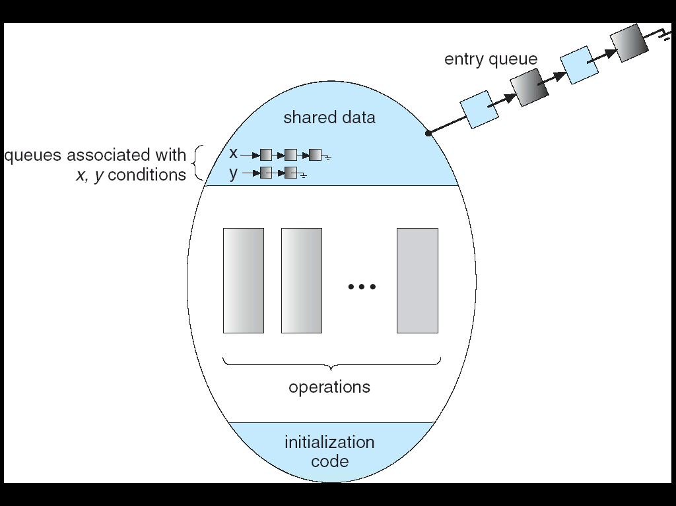
Monitors
High-level synchronization construct that allows the safe sharing of an abstract data type among concurrent processes.
type monitor-name = monitor
variable declarations
procedure entry P1 (…);
begin … end;
procedure entry P2 (…);
begin … end;
.
.
.
procedure entry Pn(…);
begin … end;
begin
initialization code
end.
Principles of Operating Systems - Process Synchronization
‹#›

Slide 64
Monitor with Condition Variables
Lock: the lock provides mutual exclusion to shared data
Always acquire before accessing shared data structure
Always release after finishing with shared data
Lock initially free
Condition Variable: a queue of threads waiting for something inside a critical section
Key idea: make it possible to go to sleep inside critical section by atomically releasing lock at time we go to sleep

Slide 65
Monitors with condition variables
To allow a process to wait within the monitor, a condition variable must be declared, as:
var x,y: condition
Condition variable can only be used within the operations wait and signal. Queue is associated with condition variable.
The operation
x.wait;
means that the process invoking this operation is suspended until another process invokes
x.signal;
The x.signal operation resumes exactly one suspended process. If no process is suspended, then the signal operation has no effect.
Principles of Operating Systems - Process Synchronization
‹#›

Slide 66
Dining Philosophers
type dining-philosophers= monitor
var state: array[0..4] of (thinking, hungry, eating);
var self: array[0..4] of condition;
// condition where philosopher I can delay himself when hungry but // is unable to obtain chopstick(s)
procedure entry pickup (i :0..4);
begin
state[i] := hungry;
test(i); //test that your left and right neighbors are not eating
if state [i] <> eating then self [i].wait;
end;
procedure entry putdown (i:0..4);
begin state[i] := thinking; test (i + 4 mod 5 ); // signal one neighbor
test (i + 1 mod 5 ); // signal other neighbor
end;
Principles of Operating Systems - Process Synchronization
‹#›

Slide 67
Dining Philosophers (cont.)
procedure test (k :0..4);
begin
if state [k + 4 mod 5] <> eating
and state [k ] = hungry
and state [k + 1 mod 5] <> eating
then
begin
state[k] := eating;
self [k].signal;
end;
end;
begin
for i := 0 to 4
do state[i] := thinking;
end;
Principles of Operating Systems - Process Synchronization
‹#›

Slide 68
Additional (extra) slides
Principles of Operating Systems - Process Synchronization
‹#›

Slide 69
Mesa vs. Hoare monitors
Who proceeds next – signaler or waiter?
Hoare-style monitors(most textbooks):
Signaler gives lock, CPU to waiter; waiter runs immediately
Waiter gives up lock, processor back to signaler when it exits critical section or if it waits again
Mesa-style monitors (most real operating systems):
Signaler keeps lock and processor
Waiter placed on ready queue with no special priority
Practically, need to check condition again after wait (condition may no longer be true!)

Slide 70
Implementing S (counting sem.) as a Binary Semaphore
Data Structures
var S1 : binary-semaphore;
S2 : binary-semaphore;
S3 : binary-semaphore;
C: integer;
Initialization
S1 = S3 =1;
S2 = 0;
C = initial value of semaphore S;
Principles of Operating Systems - Process Synchronization
‹#›

Slide 71
Implementing S
Wait operation
wait(S3);
wait(S1);
C := C-1;
if C < 0
then begin
signal (S1);
wait(S2);
end
else signal (S1);
signal (S3);
Signal operation
wait(S1);
C := C + 1;
if C <= 0 then signal (S2);
signal (S1);
Principles of Operating Systems - Process Synchronization
‹#›

Slide 72
Implementing Regions
Region x when B do S
var mutex, first-delay, second-delay: semaphore;
first-count, second-count: integer;
Mutually exclusive access to the critical section is provided by mutex.
If a process cannot enter the critical section because the Boolean expression B is false,
it initially waits on the first-delay semaphore;
moved to the second-delay semaphore before it is allowed to reevaluate B.
Principles of Operating Systems - Process Synchronization
‹#›

Slide 73
Implementation
Keep track of the number of processes waiting on first-delay and second-delay, with first-count and second-count respectively.
The algorithm assumes a FIFO ordering in the queueing of processes for a semaphore.
For an arbitrary queueing discipline, a more complicated implementation is required.
Principles of Operating Systems - Process Synchronization
‹#›

Slide 74
Implementing Regions
wait(mutex);
while not B
do begin first-count := first-count +1;
if second-count > 0
then signal (second-delay);
else signal (mutex);
wait(first-delay);
first-count := first-count -1;
second-count := second-count + 1;
if first-count > 0 then signal (first-delay)
else signal (second-delay);
wait(second-delay);
second-count := second-count -1;
end;
S;
if first-count > 0 then signal (first-delay);
else if second-count > 0
then signal (second-delay);
else signal (mutex);
Principles of Operating Systems - Process Synchronization
‹#›

